Slide 1
ML PROJECTS
AYESHA IMRAN 2023-BS-AI-057

Slide 2
PROJECT 01
Salary Prediction using Regression

Slide 3
Introduction
• Predict exact salary based on input features.
→ We aim to predict continuous salary value using regression techniques.
• Use dataset with experience, education, city.
→ The dataset contains professional and demographic info useful for prediction.
• Goal: Model gives numeric salary prediction.
→ Our objective is to automate salary estimation based on user details.

Slide 4
Dataset Description
Name: salary_prediction_updated_dataset.csv
Columns:
experience: number of years
education: level (e.g., Bachelor's/Master’s)
city: location
salary: actual amount
Categorical data encoded using LabelEncoder

Slide 5
Libraries & Methods
• pandas, numpy – Data manipulation
→ These libraries are used to clean, analyze, and manipulate datasets.
• matplotlib, seaborn – Visualization
→ They help create visual graphs like bar plots and line charts.
• sklearn.linear_model – Linear Regression
→ Linear Regression is used to learn relationships between input and output.
• train_test_split – To divide data
→ Splitting data ensures fair training and testing.
• metrics – MSE, RMSE for evaluation
→ Evaluation metrics measure how good our predictions are.

Slide 6
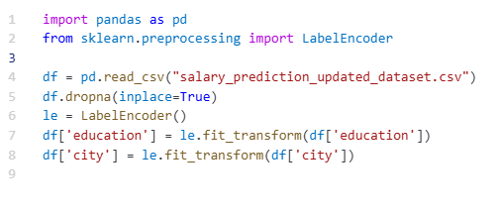
Data Preprocessing
• Load Excel/CSV file using pandas
→ We use pandas to import data and explore its structure.
• Remove missing or duplicate values
→ Data cleaning is necessary for accurate predictions.
• Encode education and city
→ Categorical columns are converted into numbers for the ML model.
• Select features: experience, education, city
→ Only important columns are selected as features.

Slide 7
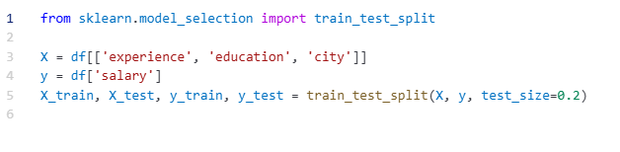
Dataset Splitting & Feature Selection
• Define features (X) and target (y)
→ Features are the inputs we give to the model, target is the output (salary).
• Split dataset: 80% training, 20% testing
→ We divide the data to train the model and later test its accuracy.

Slide 8
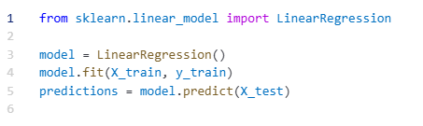
Training Linear Regression Model
• Train model on training data
→ We use LinearRegression from sklearn and fit the model.
• Learn relationship between features and salary
→ The model understands patterns like how experience affects salary.

Slide 9
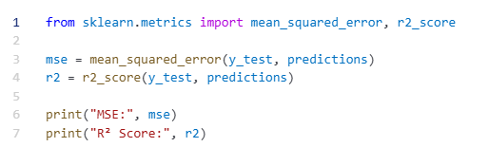
Accuracy and Error Measurement
• Evaluate using MSE, RMSE, R²
→ These metrics tell us how close our predicted salaries are to real values.

Slide 10
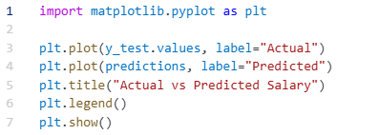
Graphs & Visualization
• Plot Predicted vs Actual Salary
→ We draw line graphs to see how well predictions match the actual data.
• Visual comparison of model performance
→ It helps understand where the model is accurate or off.

Slide 11
Conclusion
Model can predict salary from simple features
Clean data and encoding improve results
Can be extended with more features for higher accuracy
Ready for real-world applications like HR tools

Slide 12
THANK YOU

